Slide 1
Parsing of Digital Logic Sketches
Matthew Weiner
Christine Alvarado
Sarah Harris

Slide 2
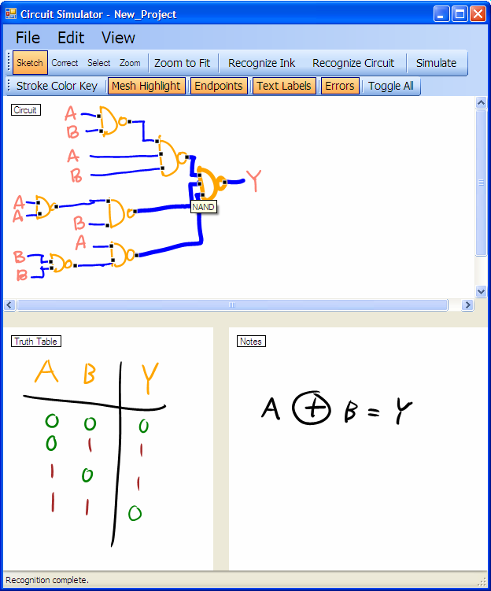
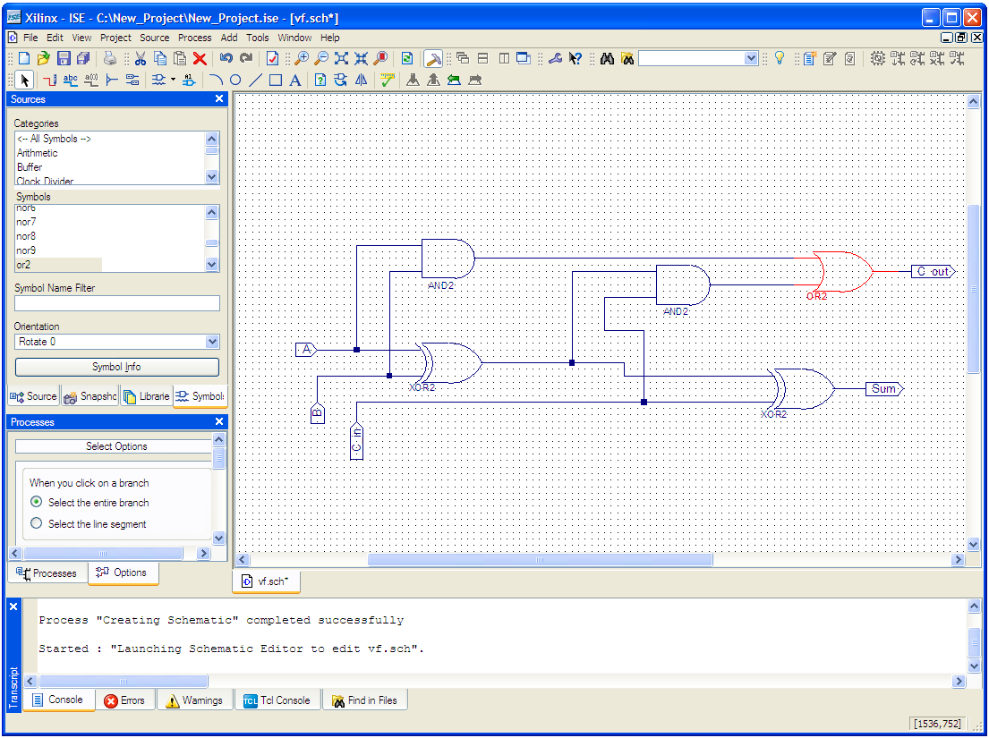
Motivation
Traditional vs. sketch-based

Slide 3
System Overview
Front End
User Interface Design
hand-drawn sketch
Recognize Symbols
Free-sketch Recognition
Construct Circuit
Diagram Parsing
Translate to Verilog
Verilog file
Simulation (Xilinx)

Slide 4
System Overview
Front End
User Interface Design
hand-drawn sketch
Recognize Symbols
Free-sketch Recognition
Construct Circuit
Diagram Parsing
Translate to Verilog
Verilog file
Simulation (Xilinx)

Slide 5
Diagram Parsing: Motivation
What do we do with recognized symbols?
  Relate symbols to each other to give meaning to the sketch
  Interpret meaning within the context of a domain
  Determine connections so that the circuit can be simulated

Slide 6
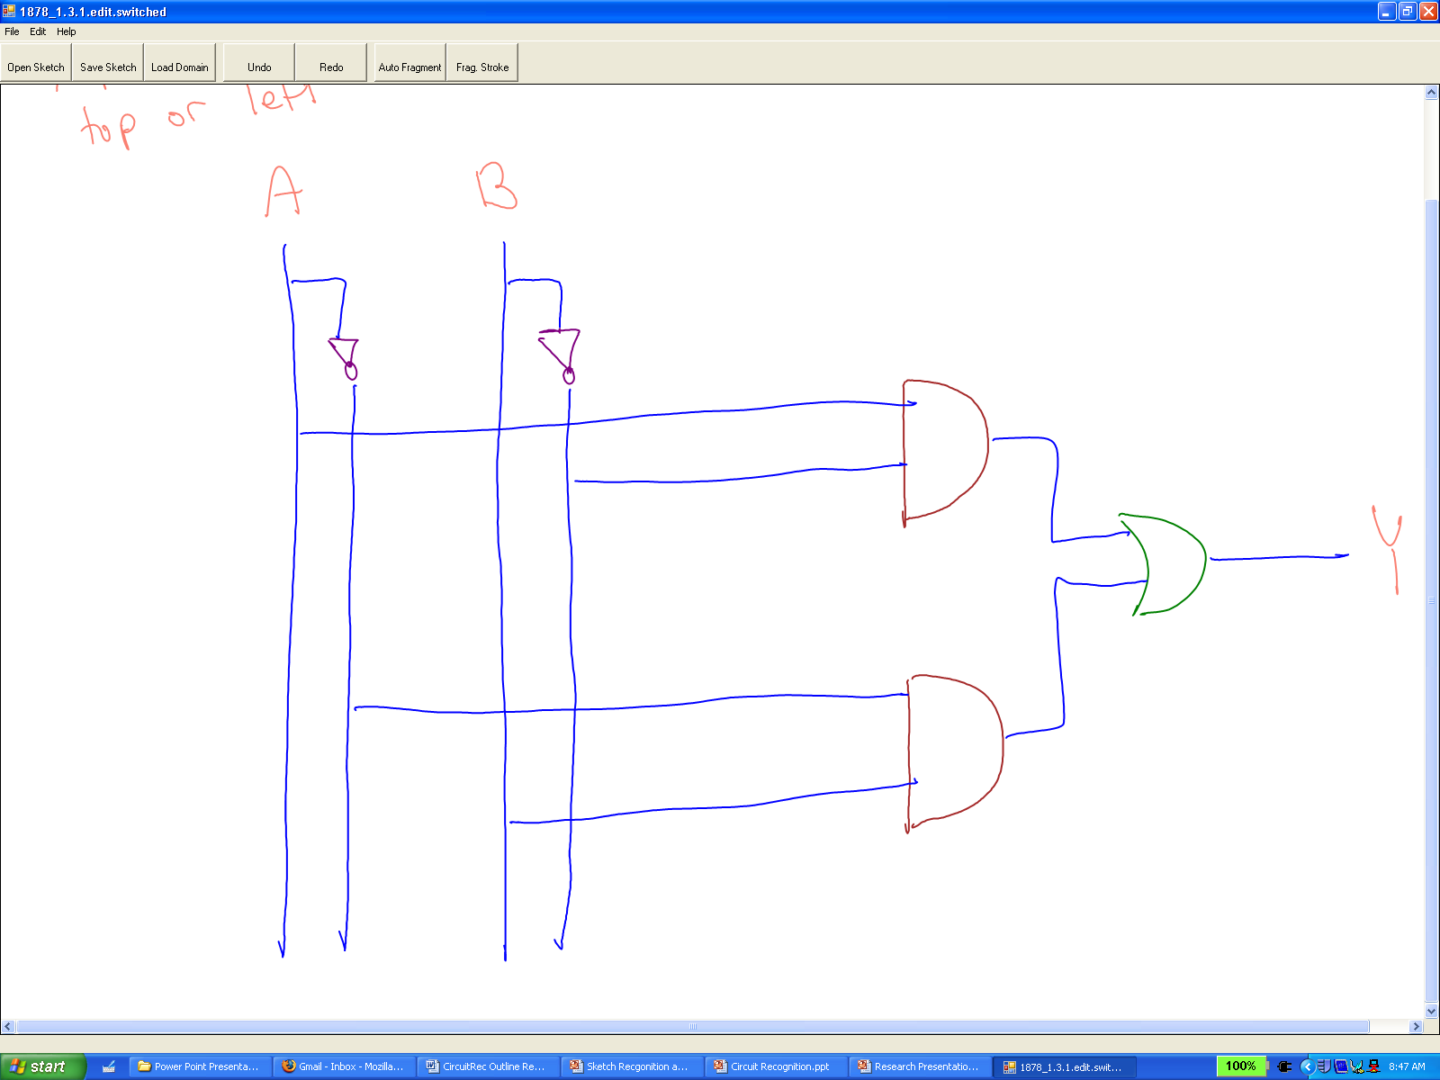
Circuit Parsing
Connect all of the recognized circuit elements together
Wire and gate
Wire and label
Wire and wire

Slide 7
Circuit Parsing: Considerations
How can the tool connect circuit elements?
How can the tool distinguish between input, output, and internal wires?

Slide 8
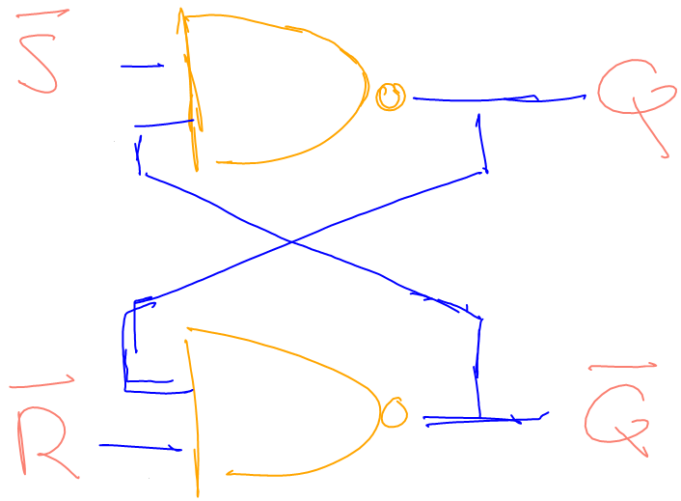
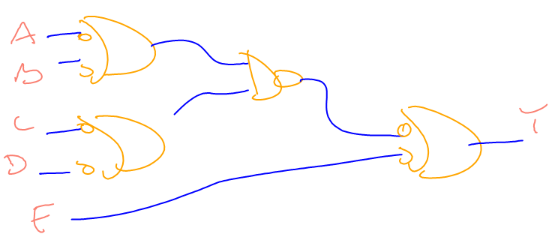
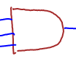
Circuit Parsing: Challenges
Connecting circuit elements
  Overstroking
  Gaps
  Non-uniform symbols
Gap
Overstroked

Slide 9
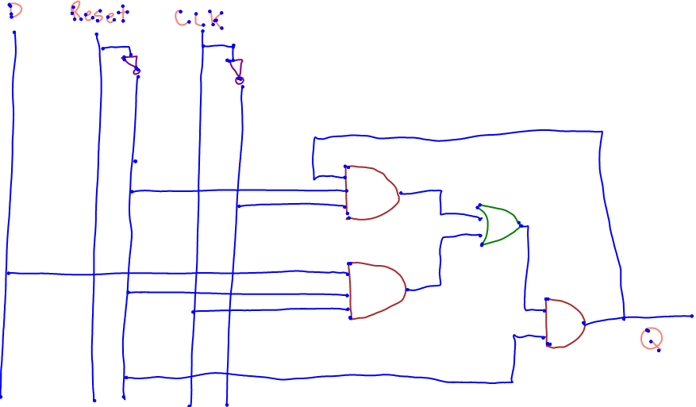
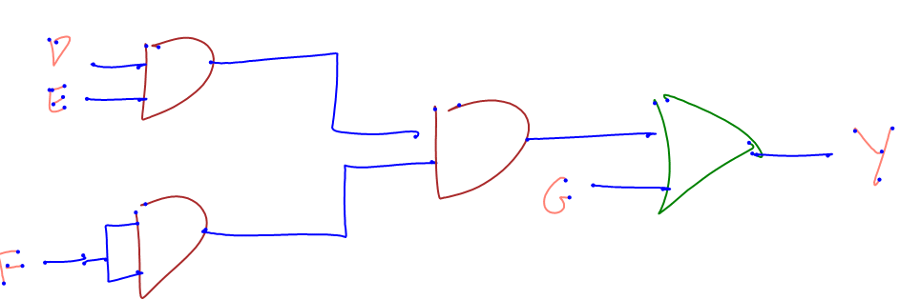
Circuit Parsing: Challenges
Determining input, output, and internal wires
  No uniform pattern

Slide 10
Circuit Parsing: Overview
Determine wire endpoints
Connect wires to gates
Connect wires to wires
Assign wire polarity

Slide 11
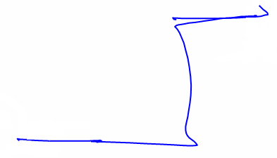
Circuit Parsing: Wire Endpoints
Wires and gates connect at wire endpoints
Use two stages to find the endpoints of each wire
Substroke endpoint
X
X
X
X
X
X
X
X
X
Endpoints of each substroke
X

Slide 12
Circuit Parsing: Stage 1
Combine or eliminate endpoints based on slope and orientation
slope = 0.05
X
X

Slide 13
Circuit Parsing: Stage 1
Combine or eliminate endpoints based on slope and orientation
right
X
X

Slide 14
Circuit Parsing: Stage 1
Combine or eliminate endpoints based on slope and orientation
right
right
left
X
X
X
X
left
left
right
X
X
X
X
right
left

Slide 15
Circuit Parsing: Stage 1
Combine or eliminate endpoints based on slope and orientation
right
right
left
X
X
X
X
left
left
right
X
X
X
X
right
left

Slide 16
Circuit Parsing: Stage 1
Combine or eliminate endpoints based on slope and orientation
X
X
X
X

Slide 17
Circuit Parsing: Stage 2
Eliminate endpoints based on proximity to other substrokes of the same wire
X
X
X
X

Slide 18
Circuit Parsing: Stage 2
Eliminate endpoints based on proximity to other substrokes of the same wire
X
X
X
X

Slide 19
Circuit Parsing: Stage 2
Eliminate endpoints based on proximity to other substrokes of the same wire
X
X

Slide 20
Circuit Parsing: Wire Endpoints
Example
Substroke endpoint
X
X
X
X
X
X
X
X
X
X
X
Endpoints of each substroke
After first stage
After second stage

Slide 21

Circuit Parsing: Gate Connections
Connect wires to gates
  Create bounding boxes around gates
  Find endpoints that intersect box
  Adjust the size of the box until the number of connections is correct
Bounding Box
X
X
X
X
X
X
X
Enough endpoints initially
Not enough endpoints initially

Slide 22
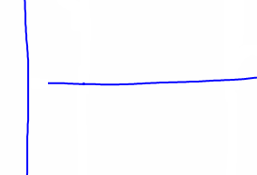
Circuit Parsing: Wire Connections
Connect wires to other wires
  Compensates for grouping errors
  Create directed bounding boxes around unconnected endpoints
  Find other wires that intersect the box
Bounding Box
X

Slide 23
Circuit Parsing: Assign Polarity
How does the tool determine whether a wire is an input, output, or internal signal?
  First try heuristics
  Use neural network if heuristics fail
Output
Input
Internal

Slide 24
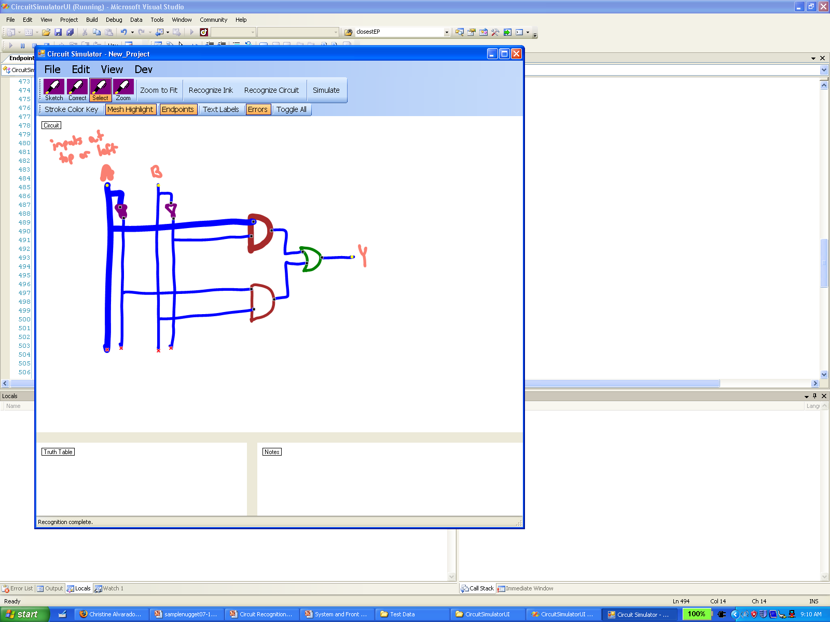
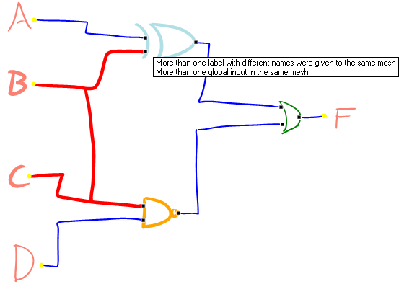
Circuit Parsing: User Feedback
Feedback of circuit parsing results
X
X
X
X

Slide 25
Results of Circuit Parsing
Perfectly labeled
  Endpoints (61 sketches)
    93.5% correct overall
    86.3% without single substroke wires
  Connections (42 sketches)
    98% correct
  I/O determination (9 sketches)
    98.6% correct
  Overall
    6 out of 9 sketches with no errors
    1-2 incorrect wires per erroneous sketch
    67 out of 71 wires correct

Slide 26
Conclusions
Operated at over 90% accuracy
Gives user feedback through mesh highlighting and endpoint painting to aid debugging
Could be extended to domains that have elements connected by lines
  Analog
  Family tree
  Flow charts

Slide 27
Future Work
Improve accuracy of endpoint algorithm
Allow for mislabeled and misgrouped strokes
Extend support to symbols with connections on more than two sides

Slide 28
Questions?

